Slide 1
Lunatone News Call – June 2023
expertise and passion for advanced technologies
and pioneering systems

Slide 2
AgendA
Introduction & objectives Günther Johler
Displays 4“/7“ Martin Jelinek
- Line extensions, functional news, emergency lighting
DALI-2 relais portfolio Günther Johler
Marketing tools Günther Johler

Slide 3
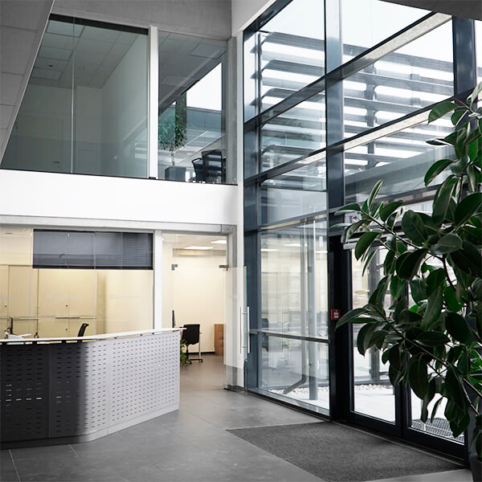
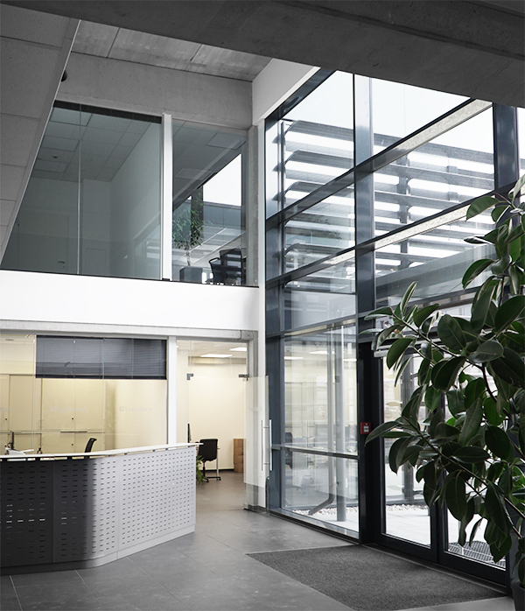
About Lunatone
30 years of experience with digital dimmable ballasts and lighting controls
Lunatone Industrielle Elektronik GmbH (2000), Location Vienna, Austria: HQ, Development, Logistic and Technical Support
Lunatone Lighting GmbH (2023), Location Dornbirn , Austria: Sales & Customer Support for Controls & Lighting management products
Location in Plovdiv, Bulgaria (2006): Lunatone BG: Production
Employees:
26 Research & Development
53 Production & Operations
14 Administration & Sales
4 Management

Slide 4
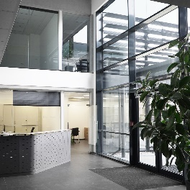
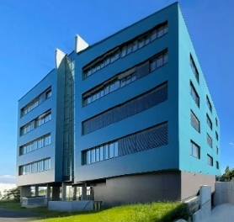
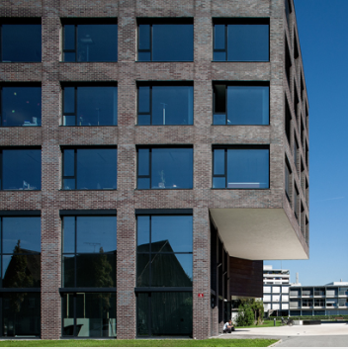
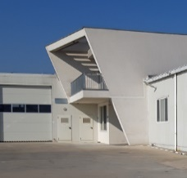
Lunatone Milestones
30 years of experience with lighting controls and digital dimmable ballasts
Lunatone Industrielle Elektronik GmbH
Vienna, Austria
starting as M&R Systems
Vienna, Austria
LunatoneBG Production facility
Plovdiv, Bulgaria
expansion production in Bulgaria
new headquarter in Vienna
extension office building headquarters
Lunatone Lighting Sales & Customer Support
Dornbirn , Office Campus V , Austria

Slide 5
Team Dornbirn

Slide 6
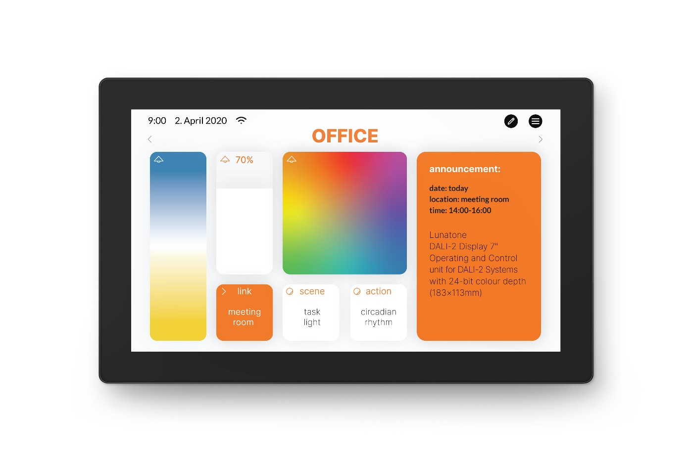
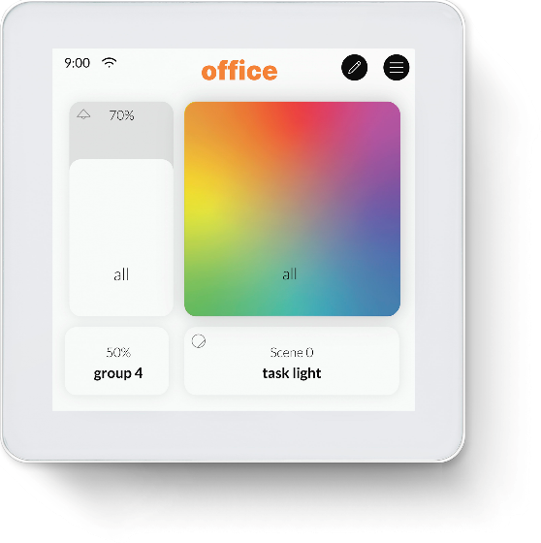
DALI-2 Displays 4“ and 7“

Slide 7
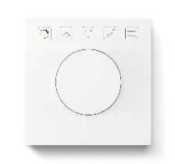
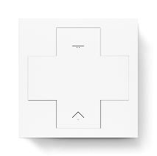
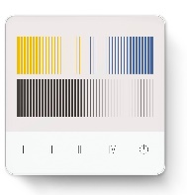
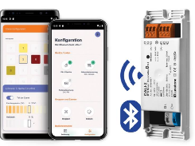
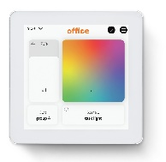
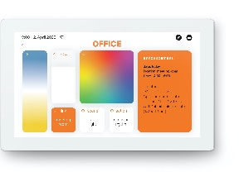
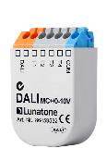
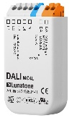
INPUT DEVICES, CONTROL UNITS & SENSORS
DALI-2 Control devices
 | DALI-2 ROT | DALI-2 ROT 3/5 | DALI-2 MC | DALI-2 MC4L | DALI-2 Switch cross | DAL-2 TOUCH PANEL | DALI -2 BT5 room controller | DAL-2 Display 4 | DAL-2 Display 7
Manual on/off and dimming | ✔️ | ✔️ | ✔️ | ✔️ | ✔️ | ✔️ | ✔️ | ✔️ | ✔️
Scenes / ON / Off / DAP / min / max |  | ✔️ | ✔️ | ✔️ | ✔️ | ✔️ | ✔️ | ✔️ | ✔️
Dynamic scenes / sequencer |  |  | ✔️ | ✔️ | ✔️ | ✔️ | ✔️ |  | ✔️
DALI DT8 / RGBWAF | ✔️ | ✔️ | ✔️ | ✔️ | ✔️ | ✔️ | ✔️ | ✔️ | ✔️
DALI DT8 /tunable white | ✔️ | ✔️ | ✔️ | ✔️ | ✔️ | ✔️ | ✔️ | ✔️ | ✔️
Macros (COT) |  |  | ✔️ | ✔️ | ✔️ | ✔️ | ✔️
NFC | ✔️ | ✔️ | ✔️ | ✔️ | ✔️
DALI configuration |  |  |  |  |  |  | ✔️ | ✔️ | ✔️
DALI-2 Instances | ✔️ | ✔️ | ✔️ | ✔️ | ✔️ | ✔️ | ✔️ | ✔️ | ✔️

Slide 8
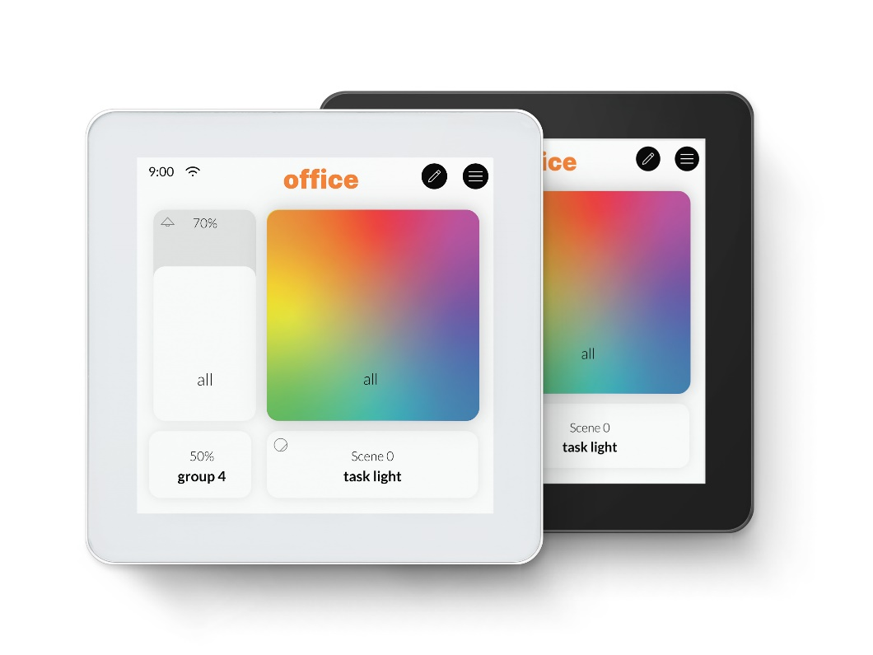
INPUT DEVICES, CONTROL UNITS & SENSORS
DALI-2 Display 4"
Multifunctional 4 " color touch screen with simple, intuitive operating interface
Application controller for 1 DALI Line
Flexible customizable screens, multiple «boards» and various widgets (control buttons / sliders).
each widget can be individually configured: function and target address (broadcast, groups and address)
Editable designs and background
standard functions: dimming, switching, scenes, tunable white (DT8 TC) and RGB (DT8 RGBWAF)
multiple devices on the same DALI line / Multimaster
DALI-2 Display 4” Plus Version: DALI Line configuration addressing, grouping, scenes
Power supply: 24V DC (PS not included)
Back box mounting
DALI-2 instance mode (IEC62386-301, Input Devices - Push Button / Absolute Input Device)
Free configurable Makro supporting all DALI / DALI 2 Commands

Slide 9
INPUT DEVICES, CONTROL UNITS & SENSORS
Installation DALI-2 Display 4”
available versions
Art. Nr. | Name
86456841-W | DALI-2 Display 4” white
86456841-B | DALI-2 Display 4” black
86456841-W Plus | DALI-2 Display 4” white Plus
86456841-B Plus | DALI-2 Display 4” black Plus
24166012-24HS | PS 24V, 300mA

Slide 10
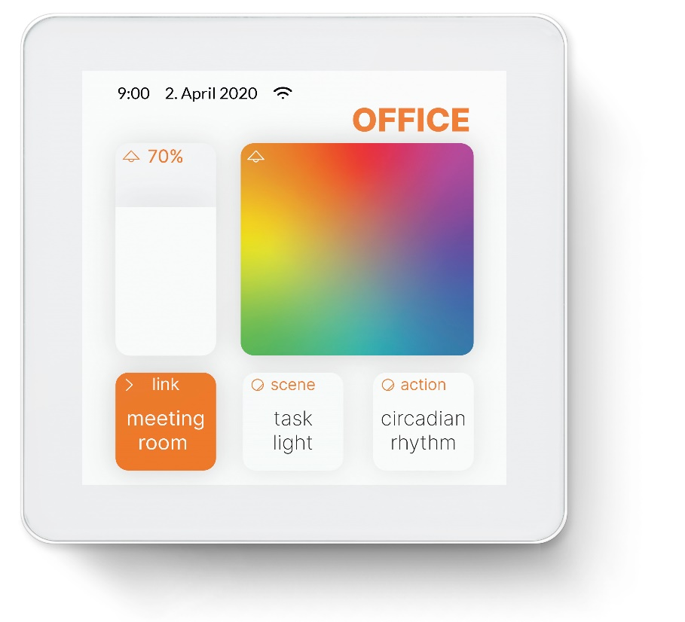
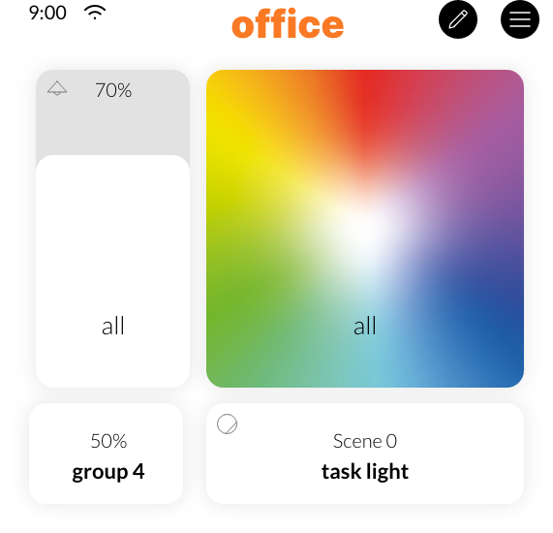
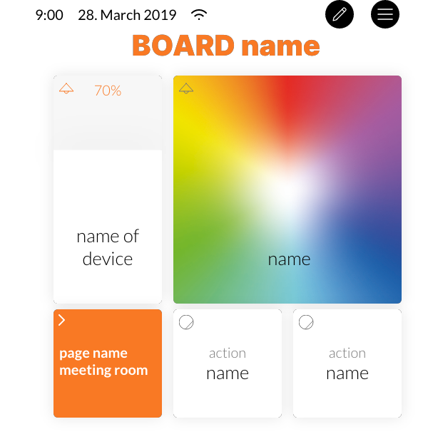
INPUT DEVICES, CONTROL UNITS & SENSORS
Installation DALI-2 Display 4”
Name of the displayed page “Board name”
Button to open menu for Set-up and configuration
Widgets: Control elements with different functions
Button to open board and widget editor
move finger up and down on the screen to navigate up and down
Swipe right and left to navigate to the next board

Slide 11
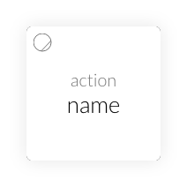
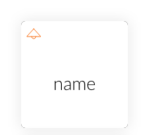
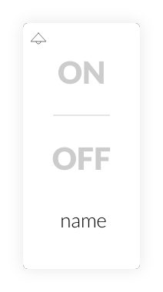
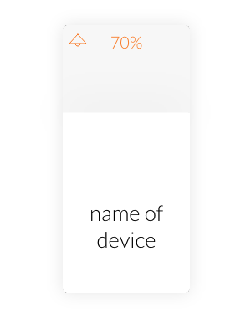
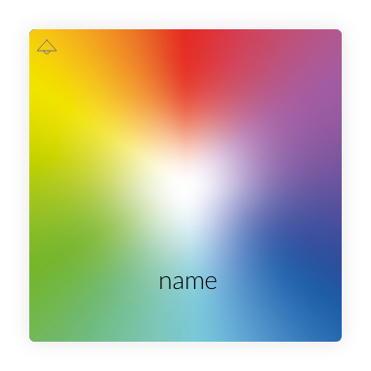
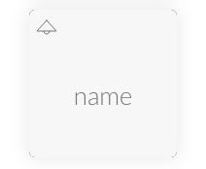
INPUT DEVICES, CONTROL UNITS & SENSORS
Widget types
Action Button -> recalls an action
ON/OFF -> toggle
ON/OFF -> separate ON and OFF button
Dimmer adjust brightness
CW-WW colour temperature selection
RGB colour selection

Slide 12
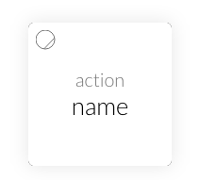
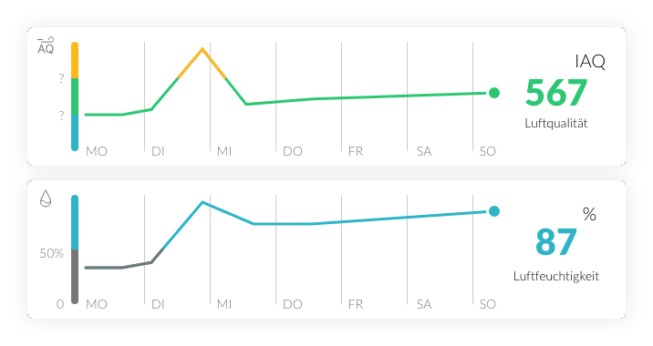
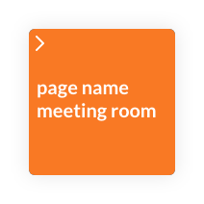
INPUT DEVICES, CONTROL UNITS & SENSORS
Widget types
Scene Button -> recalls an action
Link -> opens a defined board (e.g. to create menu pages with board overview)
Sensor -> visualizes sensor values

Slide 13
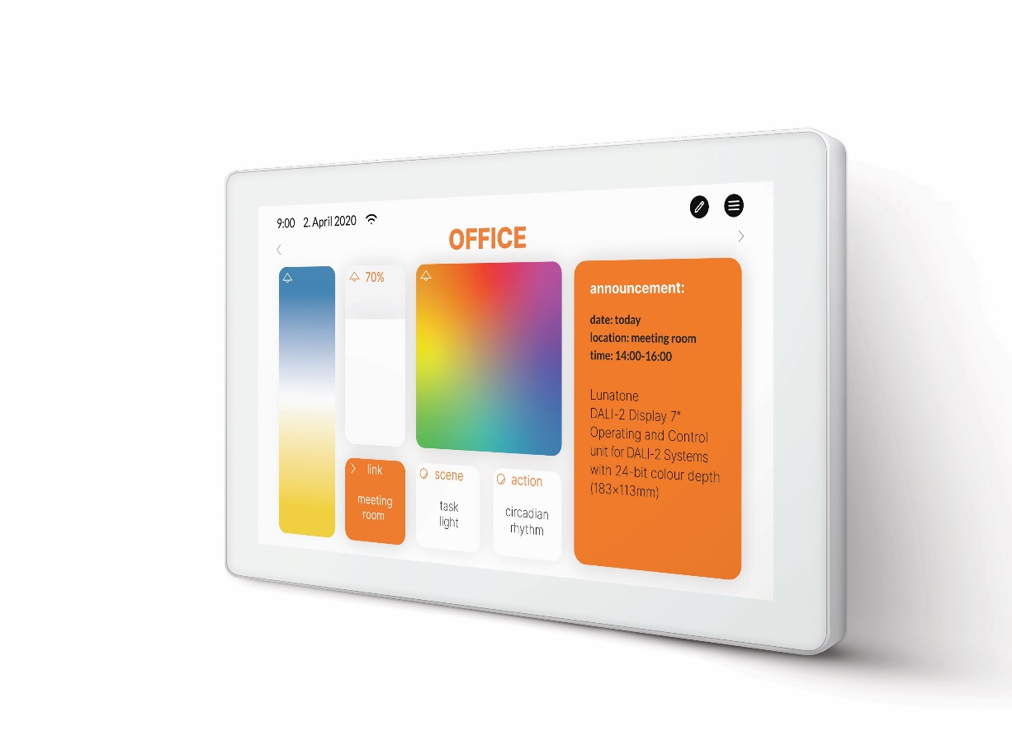
INPUT DEVICES, CONTROL UNITS & SENSORS
DALI-2 Display 7"
Multifunctional 7 " color touch screen with simple, intuitive operating interface
Application controller for 1 DALI Line
Flexible customisable screen, multiple «boards» and various widgets (control buttons / sliders).
each widget can be individually configured: function and target address (broadcast, groups and address)
Editable designs and background
standard functions: dimming, switching, scenes, tunable white (DT8 TC) and RGB (DT8 RGBWAF)
DALI Line configuration: addressing, grouping, scenes
integration via WLAN in building management systems
multiple devices on the same DALI line / Multimaster
Power supply: 24V DC
Back box mounting
Weekly scheduler, sequencer
DALI-2 instance mode (IEC62386-301, Input Devices - Push Button / Absolute Input Device)
Free configrueable Makro supporting all DALI / DALI 2 Commands

Slide 14
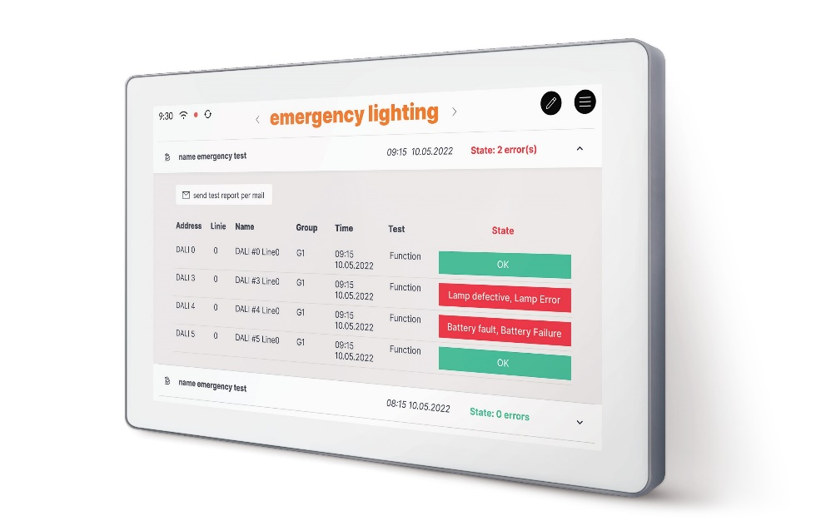
INPUT DEVICES, CONTROL UNITS & SENSORS
DALI-2 Display 7” emergency
Addressing and grouping of DALI emergency devices (DT1)
Creating and scheduling of different emergency tests:
function tests
battery duration tests
communication tests
Online test book for documentation of carried out tests on the display web interface
Display of latest tests and simple interface for error resolving
Email notification system for errors

Slide 15
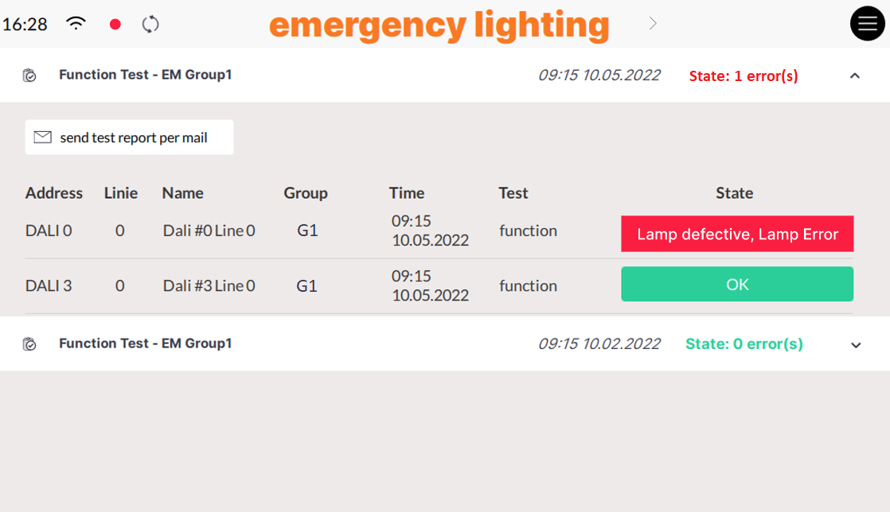
INPUT DEVICES, CONTROL UNITS & SENSORS
DALI-2 Display 7” emergency – TEST RESULTS
There is an unresolved error
Test header
Collapse or extend test details
A test is running
Summary of the test results
Send test report to the email addresses specified in the settings
Date and time of testing
Test details – results for each tested device

Slide 16
INPUT DEVICES, CONTROL UNITS & SENSORS
DALI-2 Display VERSIONS
 | Display 4 inch |  | Display 7 inch
 | BASIC | PLUS | BASIC | PLUS | Emergency | PLUS+Emergency
Índividually configurable user interface | yes | yes | yes | yes |  | yes
Integration WLAN | yes | yes | yes | yes | yes | yes
Integration LAN |  |  | yes | yes | yes | yes
Dimming and switching tunable white, RGB | yes | yes | yes | yes |  | yes
Scene configuration | yes | yes | yes | yes |  | yes
DALI group configuration |  | yes |  | yes | yes | yes
Zone creation | yes | yes | yes | yes | yes | yes
Integrated sensors |  | yes | yes | yes |  | yes
Addressing |  | yes |  | yes | yes | yes
Circadian daylight schedule |  |  |  | yes |  | yes
Sequencees |  |  |  | yes |  | yes
Schedules |  |  |  | yes |  | yes
Macro upload | yes | yes | yes | yes |  | yes
Macro editor |  |  |  | yes |  | yes
Trigger actions (for bus extension) |  |  |  | yes |  | yes
DALI Cockpit interface | yes | yes | yes | yes | yes | yes
Emergency functionality |  |  |  |  | yes | yes
DALI Bus Extension Module support |  |  |  | yes | yes | yes

Slide 17
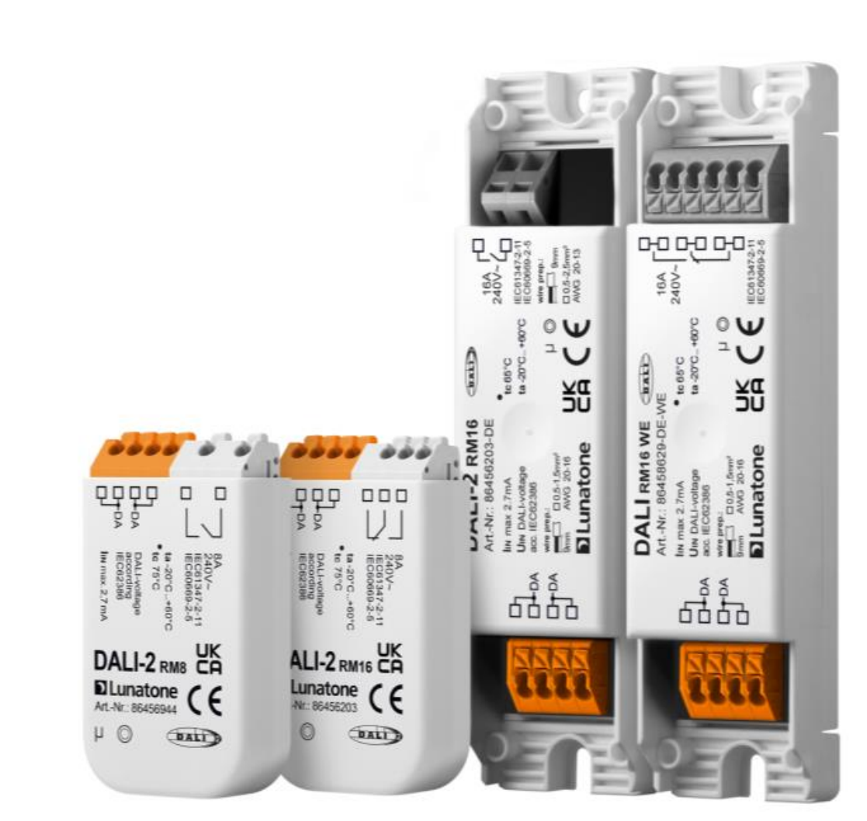
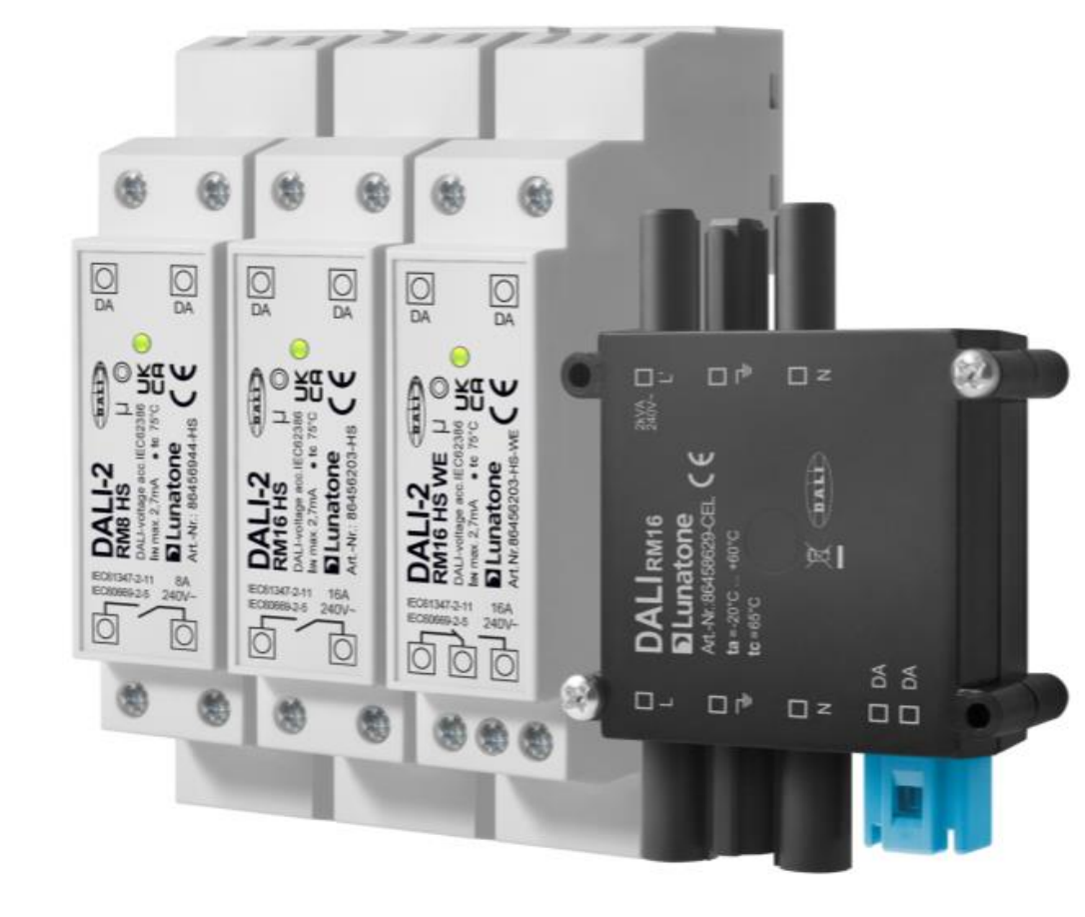
DALI-2 Relay Modules RM8 /RM 16

Slide 18
Relay Modules DALI-2 – Benefits & Features
Complete range of DALI-2 certified relais modules for integration of non-dimmable ballasts (DT7)
Flexibility of the portfolio in terms of wattage (1000-2000W), housings (DIN rail/remote ceiling/installation box) and contacts (normally open contact, changeover contact)
Long device-lifetime and high number of switching cycles, because of switching in the voltage zero crossing; Depending on the type > 30k ..50k operations (at nominal resistive load)
Easy and efficient installation, because the relays modules are powered from the DALI line and needs just 3-4mA (=> high number of address per DALI line).
versions with integrated in-rush current limitation (RM16 HS, RM16 DE).
Easy commissioning with “Identify” functions for localisation after addressing
Configurable Power-Up, System failure level via Cockpit
Definition of switching behaviour with virtual Dimming level (VDAP) – each dim direction 2 thresholds

Slide 19
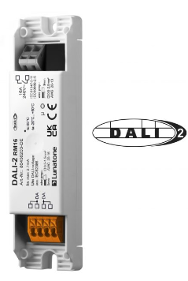
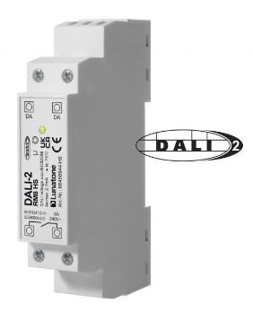
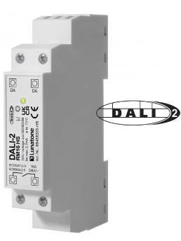
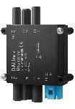
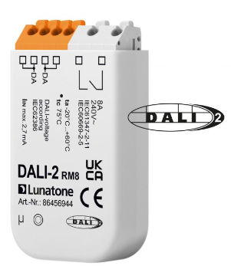
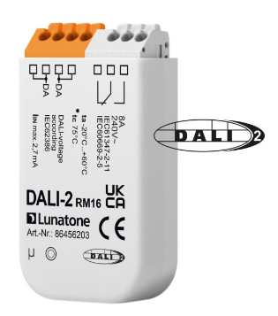
ReLAY Modules - overview
 | DALI-2 RM8 | DALI-2 RM8 DIN Rail | DALI-2 RM16 | DALI-2 RM16 DE | DALI RM16 DE WE | DALI-2 RM16 DIN RAIL | DALI-2 RM16 WE DIN Rail | DALI RM16 Wieland | wDALI RM8 | DALI 4Ch RC | DALI 4Ch RC DIN Rail
DALI-2 | ✔️ | ✔️ | ✔️ | ✔️ | ✔️ | ✔️ | ✔️ |  |  | coming soon | coming soon
switching current 8A | ✔️ | ✔️ | ✔️ |  |  |  |  |  | ✔️ | ✔️ | ✔️
switching current 16A |  |  |  | ✔️ | ✔️ | ✔️ | ✔️ | ✔️
type of relay contact | 1 make-contact | 1 make-contact | 1 changeover-contact | 1 make-contact | 1 changeover -contact | 1 make-contact | 1 changeover-contact | 1 make-contact | 1 on/off | 4 RC - | 4 RC -
wireless |  |  |  |  |  |  |  |  | ✔️
In-rush Cur. limitation |  |  |  | ✔️ |  | ✔️

Slide 20
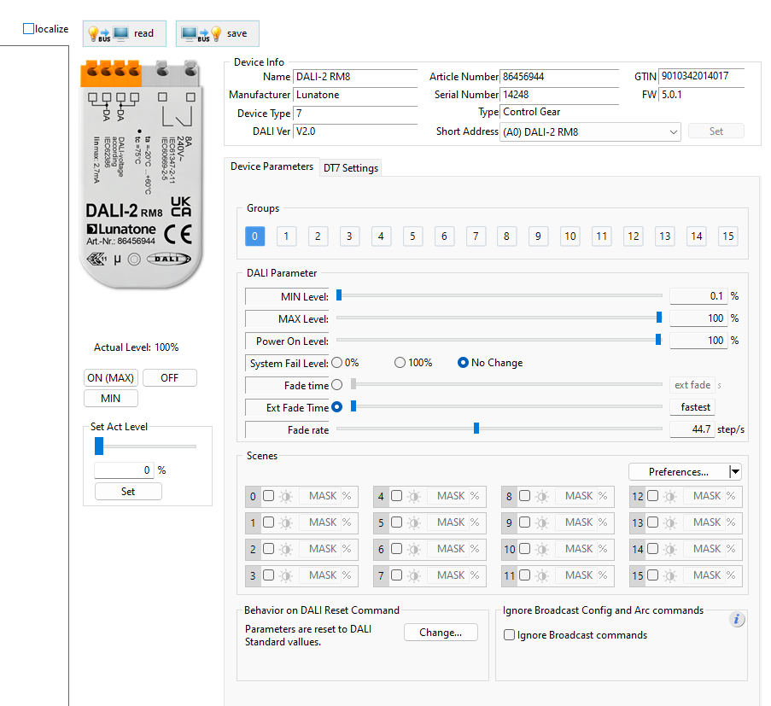
Relay Modules DALI-2 – RM8
1.
Easy commissioning & localization with „Identify /localize“ function after addressing
2.
Configurable Power-up and System failure level via Cockpit
3.
Verification of switching settings
5.
Option to ignore Broadcast for switching devices
4.
return to initial setting per individual reset command definition
cc

Slide 21
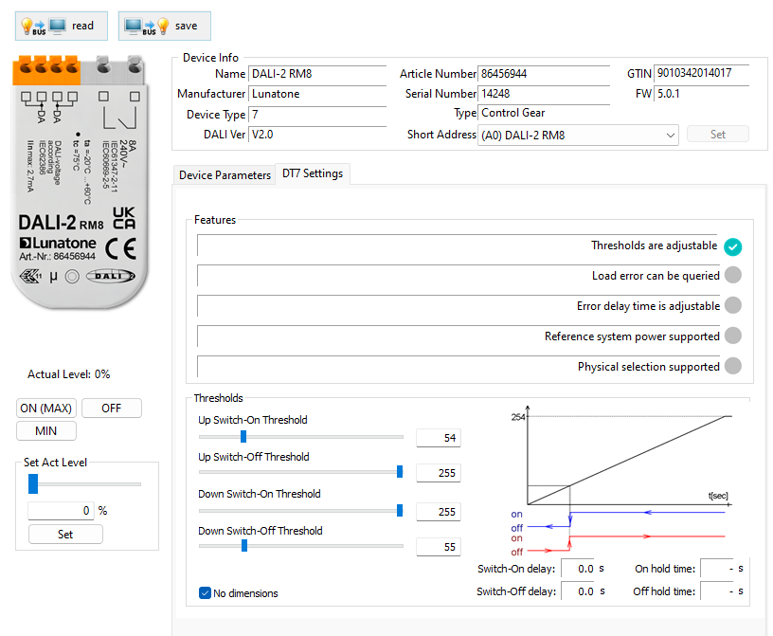
Relay Modules DALI-2 – RM8
1.
Currently not supported DALI-2 functions
2.
Definition of switching behaviour with VDAP – 2 thresholds for each dimming direction
3.
Coming soon - already in test with newest firmware; For delay relay function

Slide 22
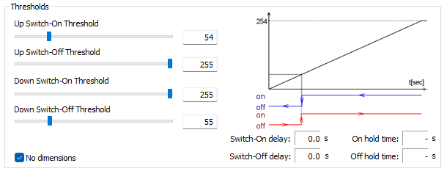
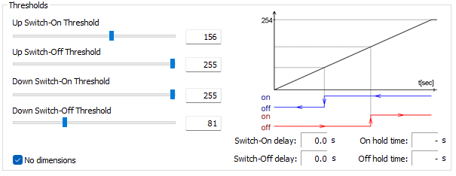
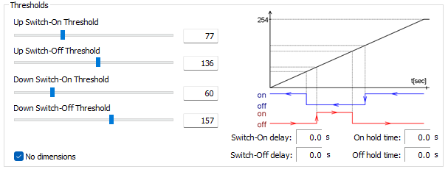
Relay Modules DALI-2 – RM8
Same threshold for ON/OFF at Up/Down dimming
Typical UseCase: e.g. synchronised on-switching in case of ballast /devices with non-zero on/off
Hysteresis for ON/OFF at Up/Down dimming
Typical UseCase: e.g. Hysteresis for simple daylight harvesting systems
Pulse for ON/OFF at Up/Down dimming
Typical UseCase: e.g. isolated contacts as interface to other systems; pulse interfaces

Slide 23
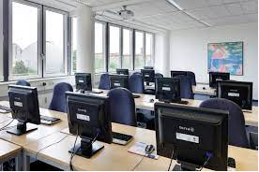
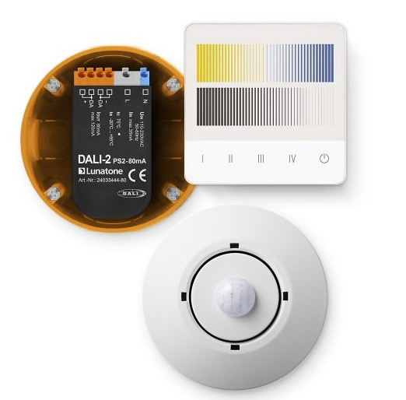
Marketing Tools
Lunatone Training offer
DALI Lighting Controls Training
Lunatone Product training
Target group: electrical contractor, everybody interested
Content:
- DALI Basics
- Lunatone product portfolio
- Concept Lunatone controls / examples
- Hands on training1: application broadcast
- Hands on training2: application addressed
- Configuration with DALI cockpit
- Error diagnosis & tests
Places & Dates:
- 21.06.2023 Berlin (German)
- 22.06.2023 Hannover (German)
- next tbd.
Costs:
- 490€
Target group: KeyAccount, sales partner, customer
Content: to be defined, customer requests
Places & Dates: defined per appointment / availability of ressources

Slide 24
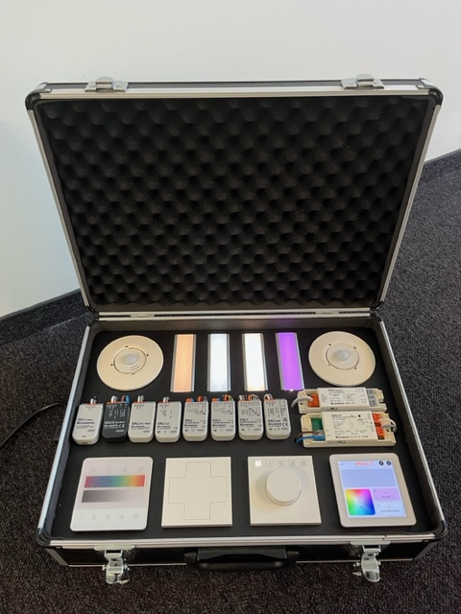
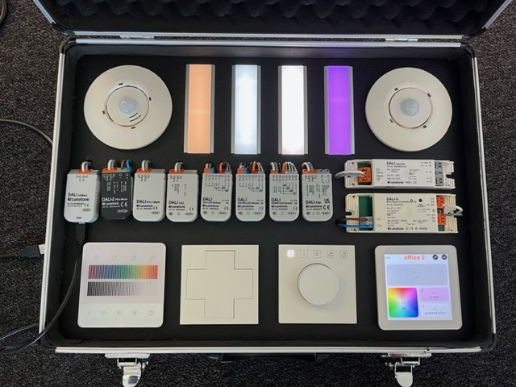
Marketing Tools
Lunatone Training Case
The Lunatone Training Case contains the most frequently used modules from the Lunatone portfolio and is perfect for product and DALI trainings.
The latest version also has a DALI terminal for connecting external DALI devices or luminaires.
Content:
DALI-2 Touchpanel
DALI-2 Display 4
DALI-2 Rot Touch
DALI-2 Switch Cross
DALI-2 CS
4 LED Stripes
DALI USB mini
DALI-2 PS2 80mA
DALI RTC Timer
DALI CDC
DALI-2 Ch LED Dimmer
DALI CW-WW LED Dimmer
DALI RGBW LED Dimmer
DALI-2 RM8
DALI Jalousie
DALI-2 BT5 Room Controller
Price: 1.792€
Delivery time: 4 weeks
Article number: SK V01

Slide 25
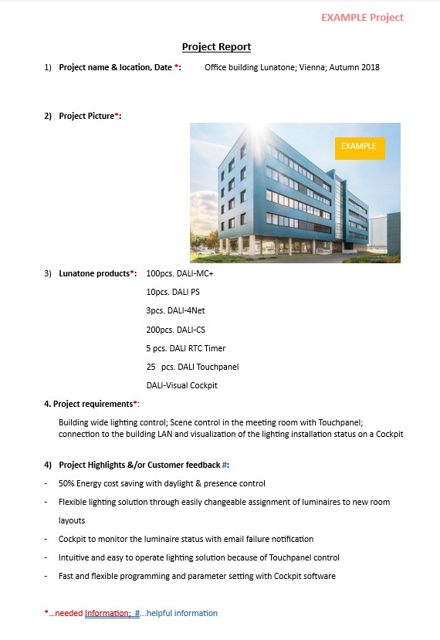
Marketing Tools
Application projects references & examples
In order to provide you marketing and training documents with practical examples in future, we need your help!
.
We asked you for sample projects, with some basic information
2. Usage of your project examples
Application reports
Training examples
Brochure
LinkedIn posts
3. Co-marketing of your Company &
Lunatone products
Multi-channel marketing, always with your brand name first
Reference list of partner projects
Shared costs for photo / report possible
Benefit from examples in other regions

Slide 26
Marketing Tools
Marketing tools planned:
Lunatone application presentations
New Version of Lunatone Brochure
Lunatone New Products – Video in Youtube
https://www.youtube.com/watch?v=RWsRsXpFx7Y
Content:
Customer demands per application
Application examples
Reference projects
Starting: July 2023
Content:
Application examples
Product portfolio overview
product description
Target release date: Aug/Sept 2023
Introducing new products – features & commissioning
Starting: September 2023

Slide 27
Thank you for your attention!
We look forward to working together on future projects.
expertise and passion for advanced technologies
and pioneering systems

